Slide 1
DDoS Botnet Attack Detection

Slide 2
Contents
Introduction
Challenges
Process steps

Slide 3
1.
Introduction

Slide 4
Introduction
Prevent DDoS Attacks from IOT-Devices by analyzing packets and detecting malicious ones

Slide 5
Datasets
We use two datasets (both in kaggle):
DDoS Botnet Attack on IOT Devices (2020-03-06)
IDS 2018 Intrusion (2018-03-02 version)
https://www.kaggle.com/siddharthm1698/ddos-botnet-attack-on-iot-devices
https://www.kaggle.com/solarmainframe/ids-intrusion-csv

Slide 6
Related Works
There is a paper based on the first dataset:
Towards the development of realistic botnet dataset in the Internet of Things for network forensic analytics: Bot-IoT dataset
https://www.sciencedirect.com/science/article/abs/pii/S0167739X18327687

Slide 7
2.
Challenges

Slide 8
Challenges
So many columns!
Fortunately we had enough knowledge in the field to decide which columns to use and which to drop.
Resampling (in Dataset 1)!
We also tried SMOTE method, but it was too resource consuming. It seems the 100% accuracy problem with Dataset 1 is because of unblaanced target varibale.

Slide 9
3. Process Steps

Slide 10
Dataset statistics
Dataset 1
47 columns
1927107 rows
Dataset 2
80 columns
1048575 rows
P1. General data statistics

Slide 11
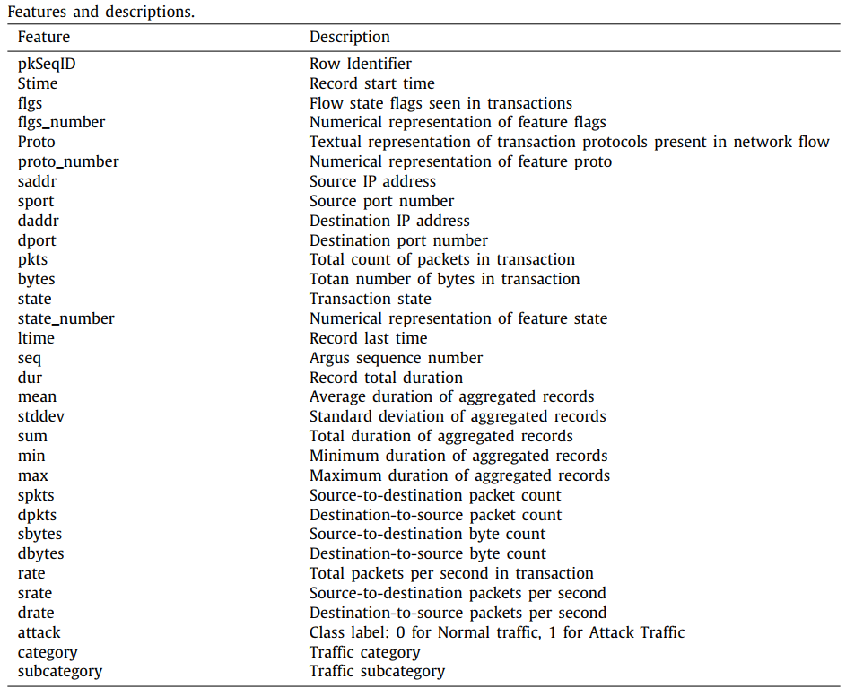
P1. General data statistics

Slide 12
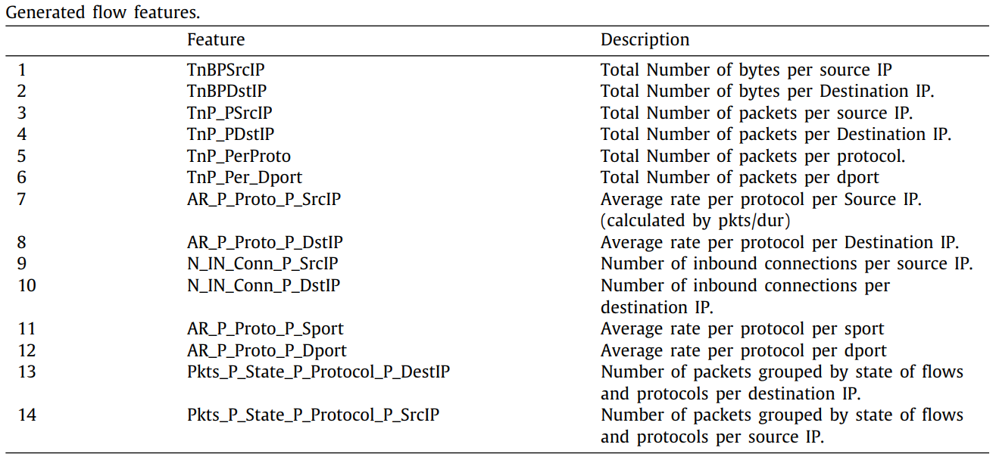
P1. General data statistics

Slide 13
Dropping some columns
Removing useless columns such as:
Unnamed, pkSeqID
Removing irrelevant and duplicate columns:
saddr, daddr, flgs-numbers
P2. EDA

Slide 14
Categorical columns
Converting categorical variables into dummy variables:
subcategory
flgs
In the second dataset, data is already encoded.
P2. EDA

Slide 15
Correlation
Check out correlation within columns using heatmap
Drop columns with correlation more that 95
P2. EDA

Slide 16
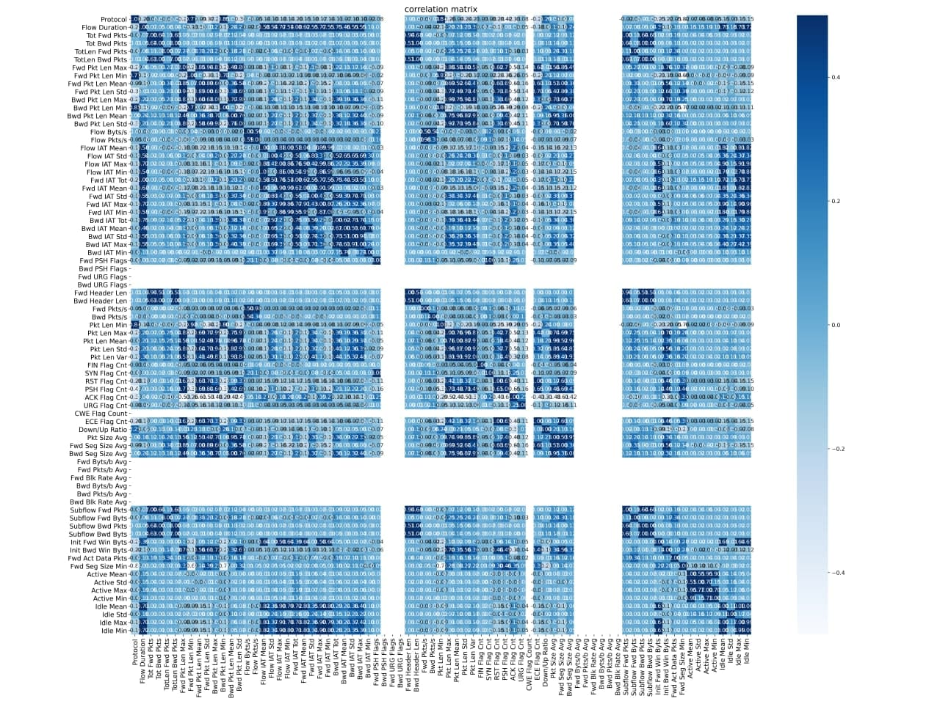
Correlation
Same process in Dataset 2
P2. EDA

Slide 17
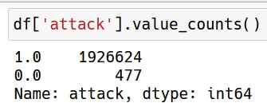
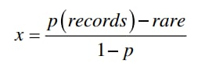
Resampling (Dataset 1)
Check out distribution of target column
477 Benign
1926624 Malicious
P = 0.3
rare = 477
records = 1927101
P2. EDA

Slide 18
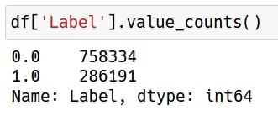
Resampling (Dataset 2)
Check out distribution of target column
758334 Benign
286191 Malicious
No need of resampling for this dataset.
P2. EDA

Slide 19
Preprocessing
There is no null value in both of the datasets
We normalize datasets with Min-Max Scaler
Dataset is split to train and test with the proportion of 0.2
P3. Data Preprocessing

Slide 20
Models
We have used Random Forest with 100 trees.
As builtin says, “Random forest is a flexible, easy to use machine learning algorithm that produces, even without hyper-parameter tuning, a great result most of the time”
Also it is great with high dimensional datasets and robust to outliers.
Also a Decision Tree is used because of it’s Interpretability.
P4. Model Architecture

Slide 21
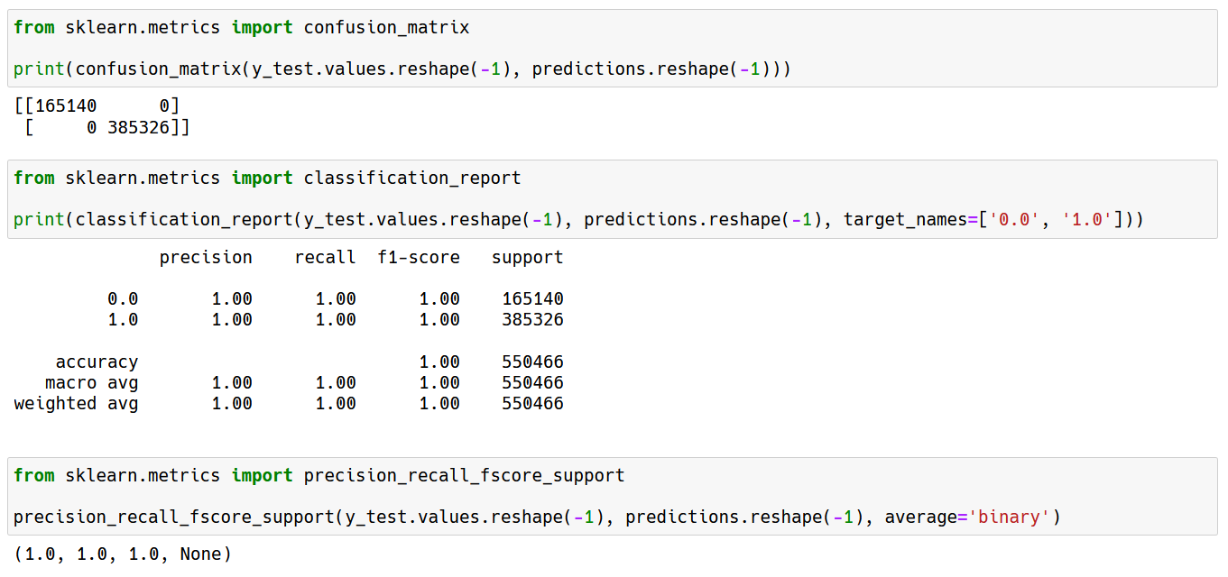
Evaluation (Dataset 1)
Evaluation using confusion matrix and classification report:
P5-6. Model Results

Slide 22
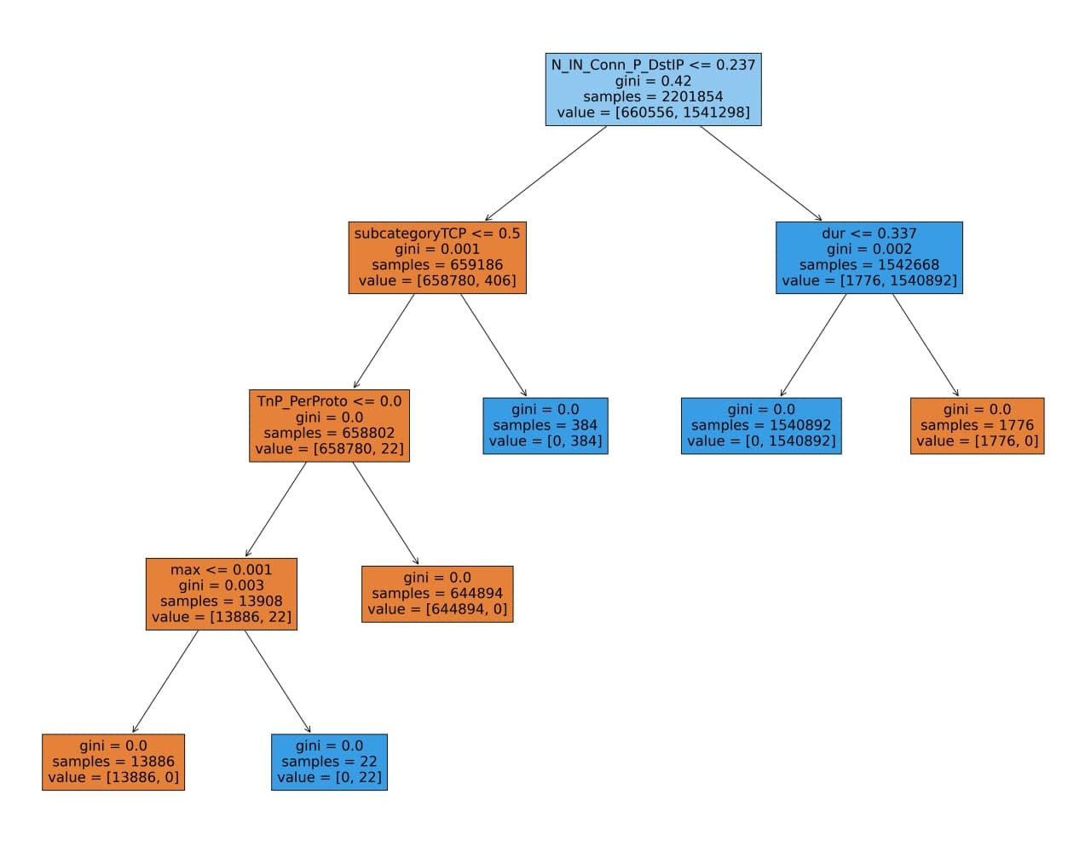
DecisionTree (Dataset 1)
We also tried DecisionTree for this dataset:
The same results as random forest are obtained.
P5-6. Model Results

Slide 23
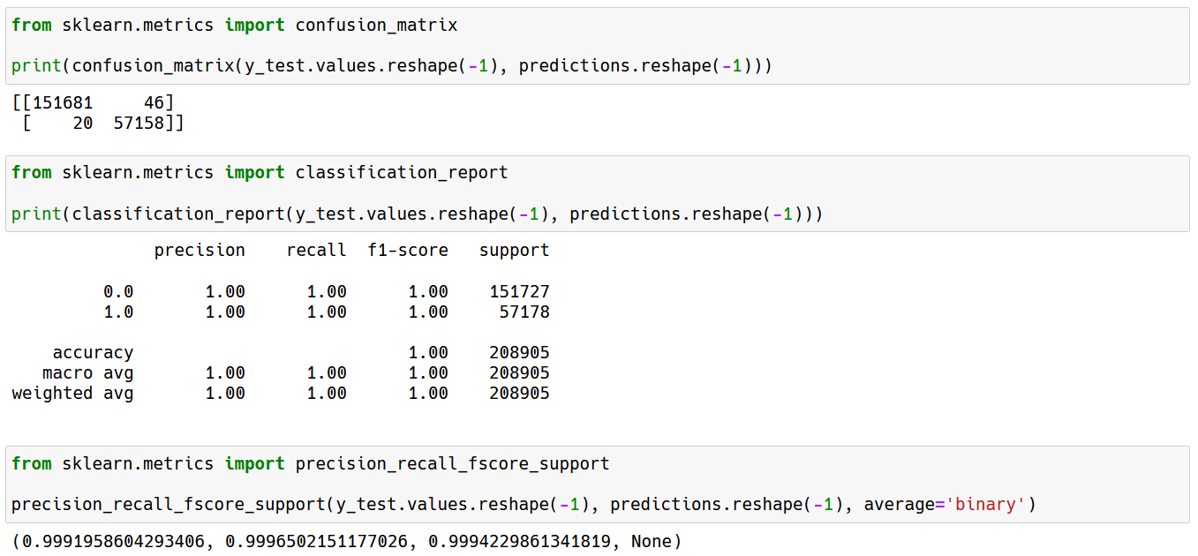
Evaluation (Dataset 2)
Evaluation For Dataset 2:
P5-6. Model Results

Slide 24
Improvements
As the results shows, the models are working great and there is no need to improve them.
We have used the same process which is taught during the lesson and as we see it works great on our subject.
P7-8. Improving models and conclusion

Slide 25
Thanks!
Any questions?

